Slide 1
Introduction to networking
TCP/IP Five-Layer Network Model
Joel Enrique Esparza Ramirez
Internet of Things

Slide 2
Lectures
1. Introduction to Networking
2. The Network Layer
3. The transport and application Layer
4. Wireless connections

Slide 3
Introduction to Networking
TCP/IP Five-Layer Network Model

Slide 4
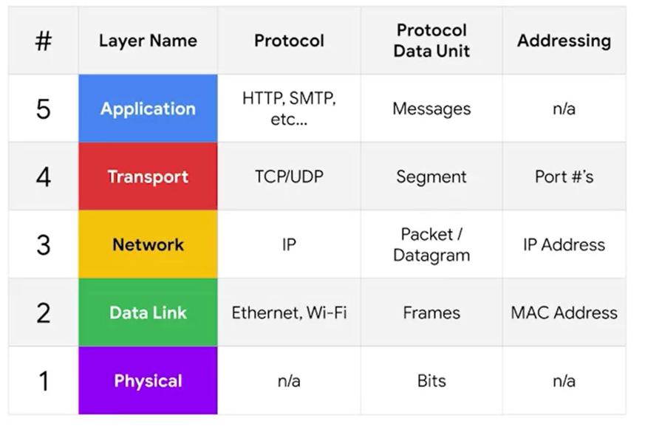
TCP/IP Five-Layer Network Model

Slide 5
Layer 1 physical
Represents the physical devices that interconnect computers

Slide 6
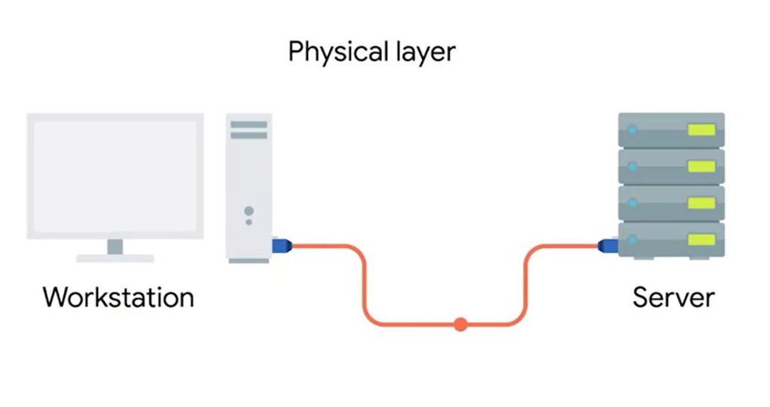

Slide 7
Layer 2 data link
Responsible for defining a common way of interesting these signals so network devices can communicate

Slide 8
ethernet
The Ethernet standards also define a protocol responsible for getting data to nodes on the same network

Slide 9
Layer 3 Network
Allows different networks to communicate with each other through devices known as routers

Slide 10
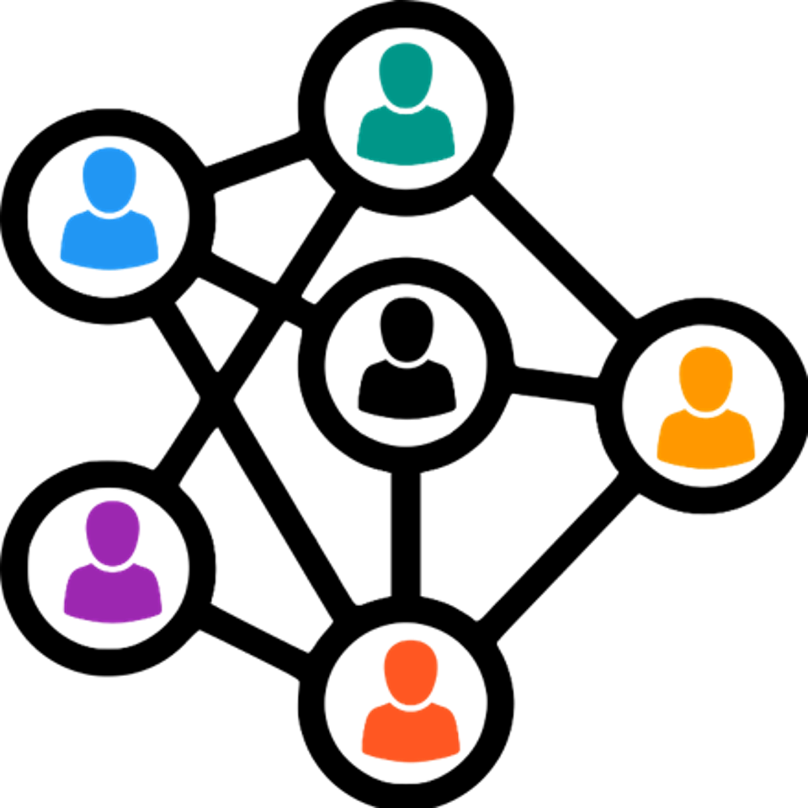

Slide 11
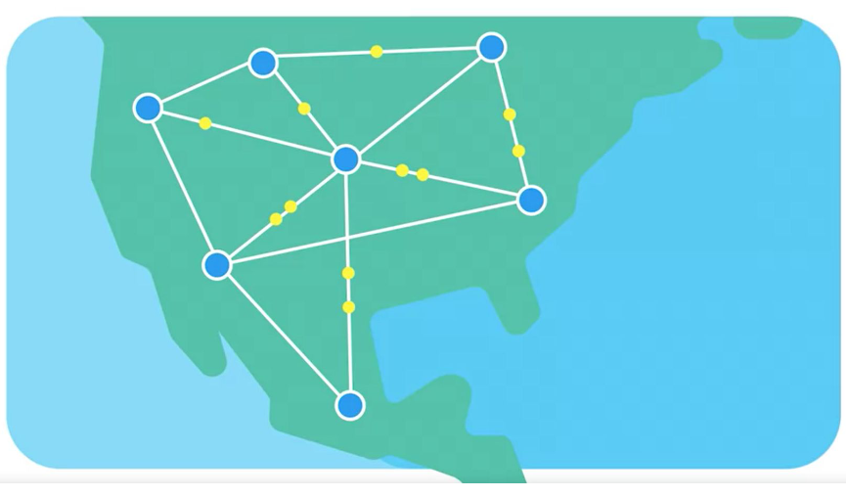

Slide 12
internetwork
A collection of networks connected together through routers, the most famous of these being the internet

Slide 13
Internet protocol
IP is the heart of the internet and most smaller networks around the world

Slide 14
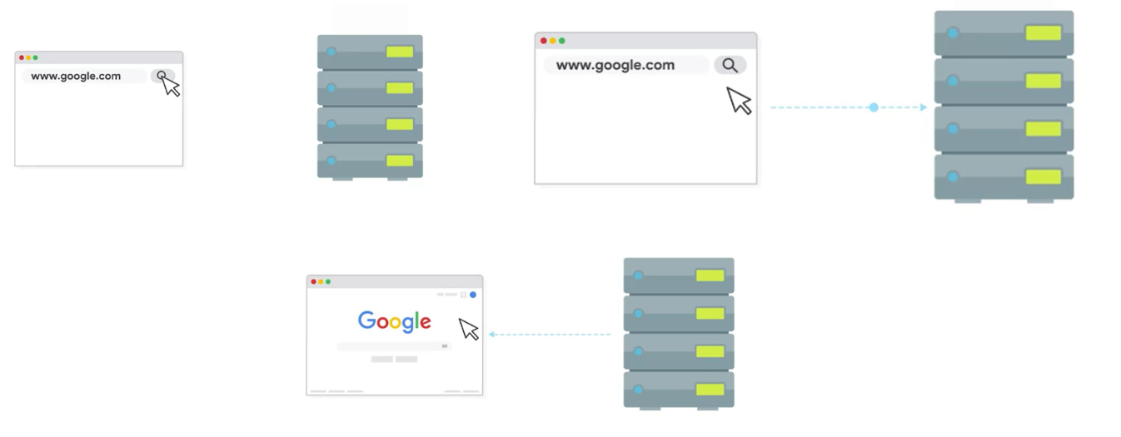
Client Server

Slide 15
Layer 4 transport
Sorts out which client and server programs are supposed to get that data

Slide 16
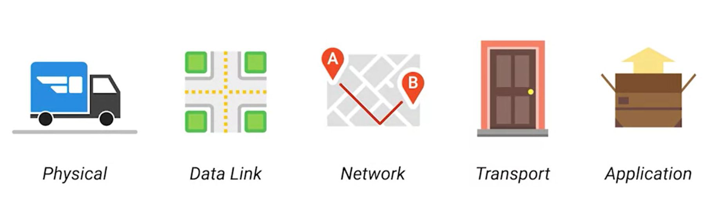

Slide 17
Osi model

Slide 18
Introduction to Networking
The basics of networking devices

Slide 19
cables
Connect different devices to each other, allowing data to be transmitted over them

Slide 20
Cables
Copper (Spanish)
Fiber (Spanish)

Slide 21
Cables
The most common forms of copper twisted-pair cables used in networking are Cat5, Cat5e and Cat6 cables

Slide 22
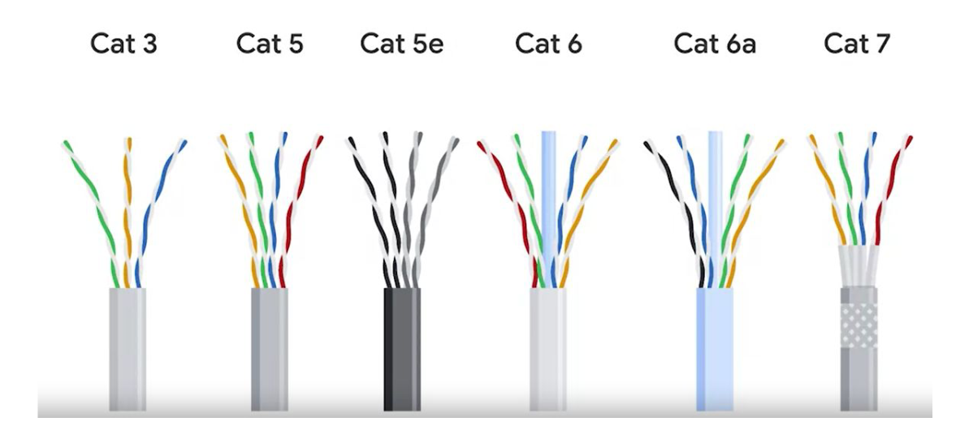

Slide 23
crosstalk
When an electrical pulse on one wire is accidentally detected on another wire

Slide 24
Fiber cables
Contain individual optical fibers, which are tiny tubes made out of glass about the width of a human hair

Slide 25
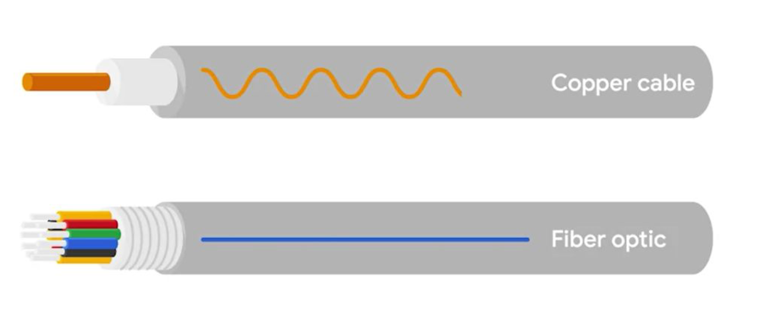

Slide 26
Recap layer 1

Slide 27
HUB
A physical layer device that allows for connections from many computers at once

Slide 28
HUB
A hub is a basic networking device that connects multiple computers or other network devices together. It operates at the physical layer (Layer 1) of the OSI model. When a data packet arrives at one port, it is copied to all other ports so that all segments of the LAN can see all packets.

Slide 29
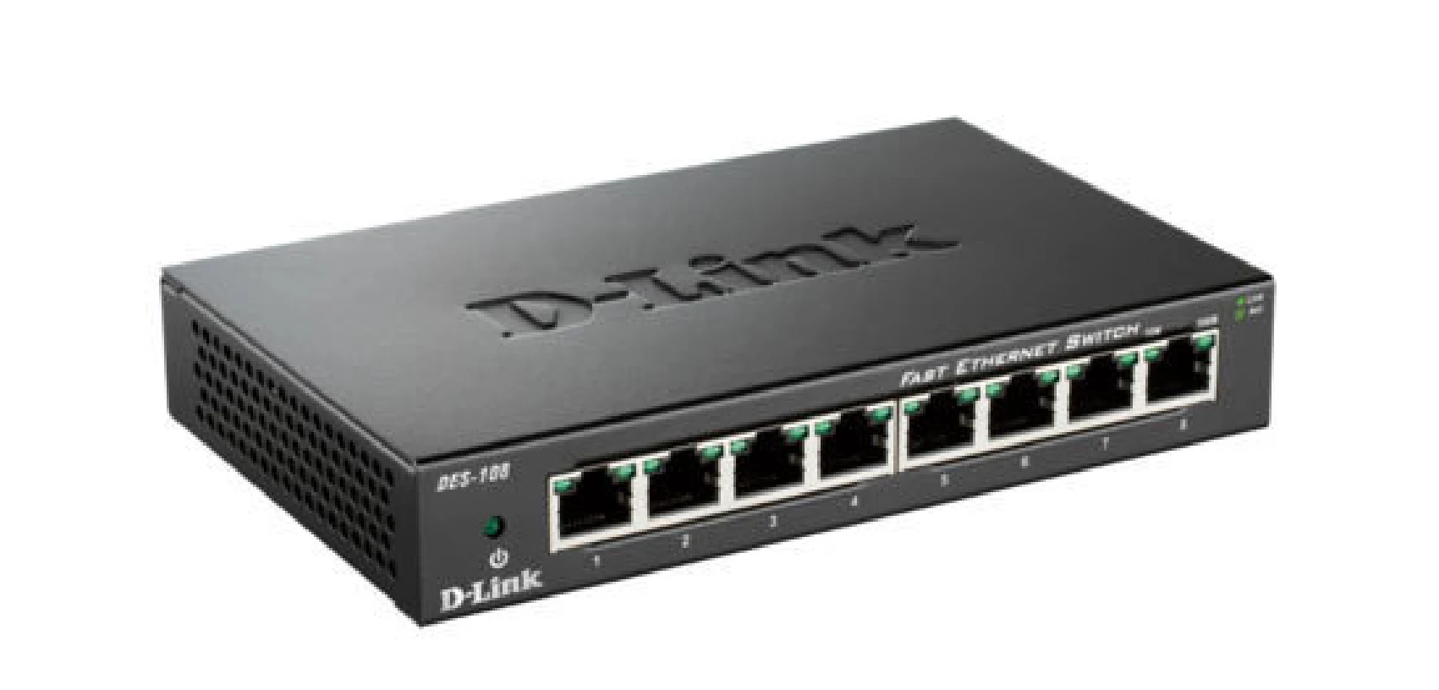

Slide 30
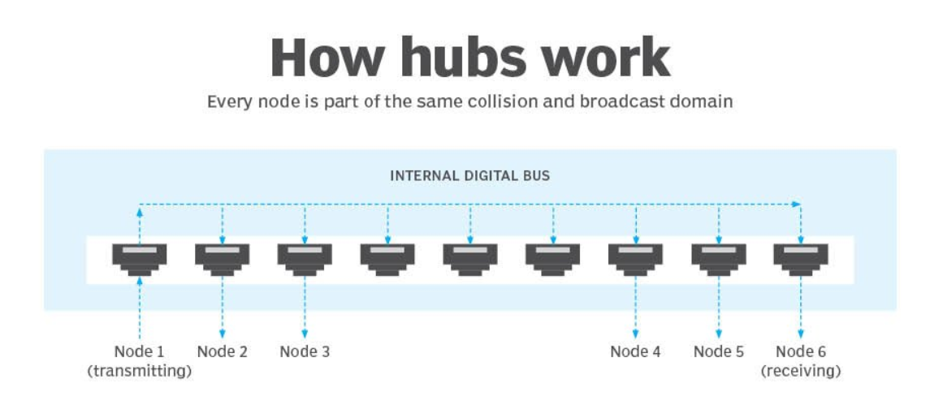

Slide 31
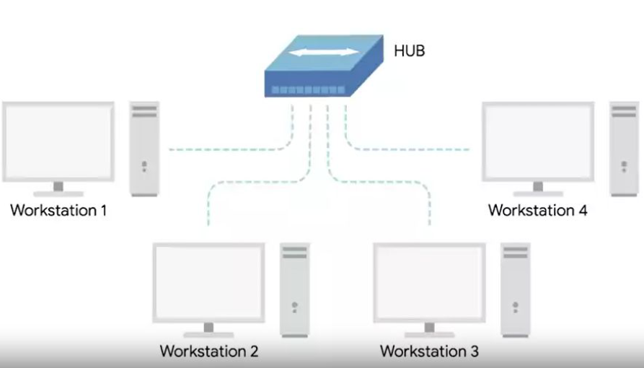

Slide 32
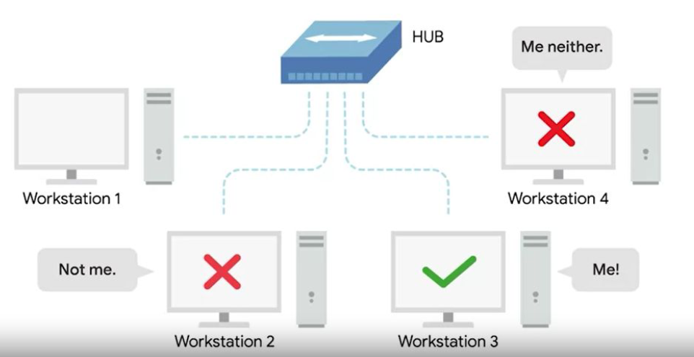

Slide 33
Collision domain
A network segment where only one device can communicate at a time

Slide 34
Collision domain
If multiple systems try sending data at the same time, the electrical pulses sent across the cable can interfere with each other

Slide 35
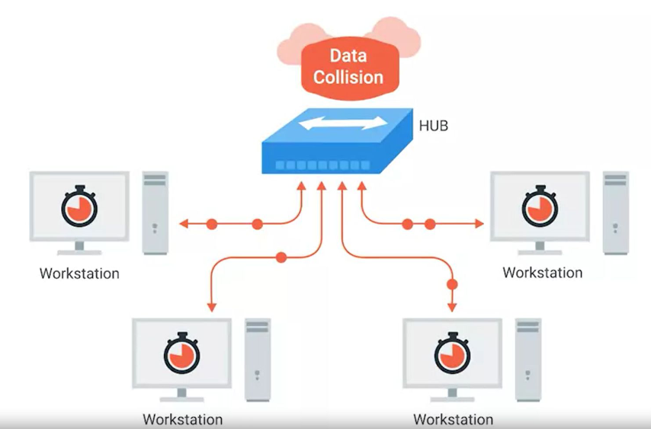

Slide 36
Switch
A switch, on the other hand, operates at the data link layer (Layer 2) of the OSI model. It is more advanced than a hub. A switch can inspect the data packets coming in and make decisions about where to send them based on their MAC addresses. Essentially, it can direct packets only to the device that is meant to receive them, rather than broadcasting to all devices.

Slide 37
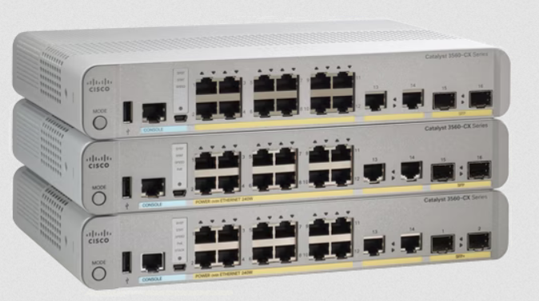
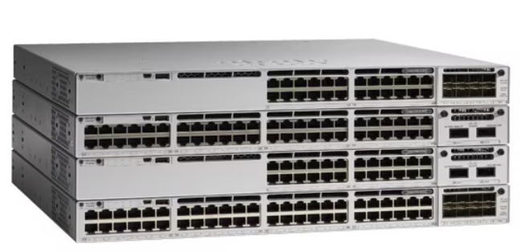

Slide 38
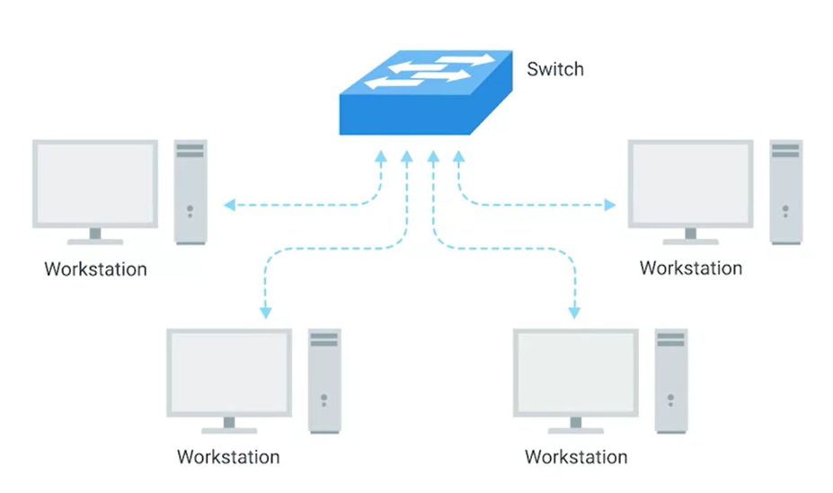

Slide 39
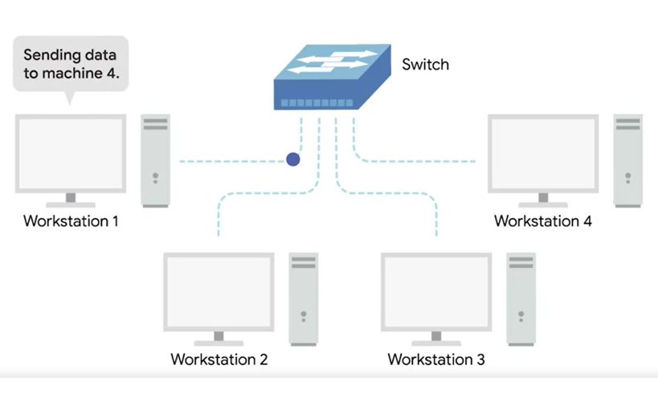

Slide 40
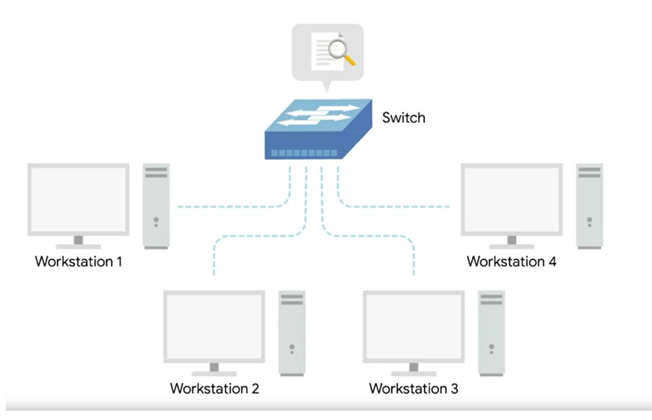

Slide 41
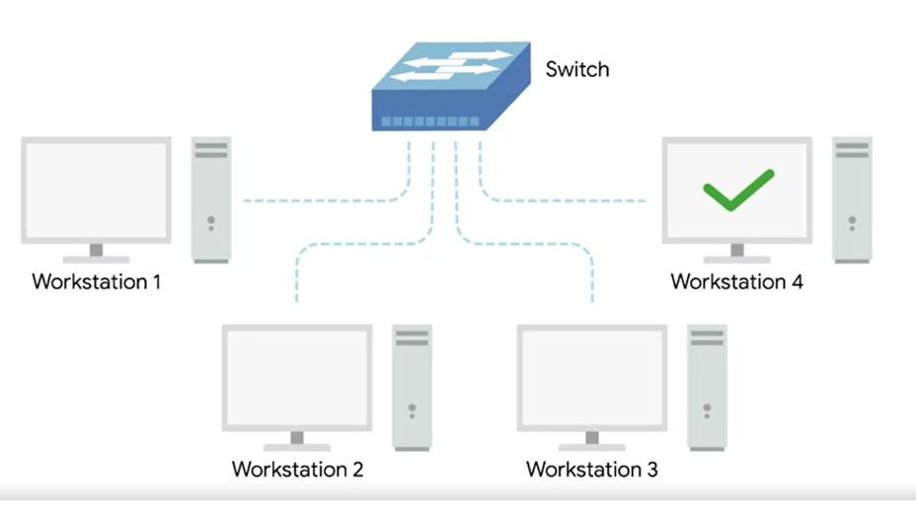

Slide 42
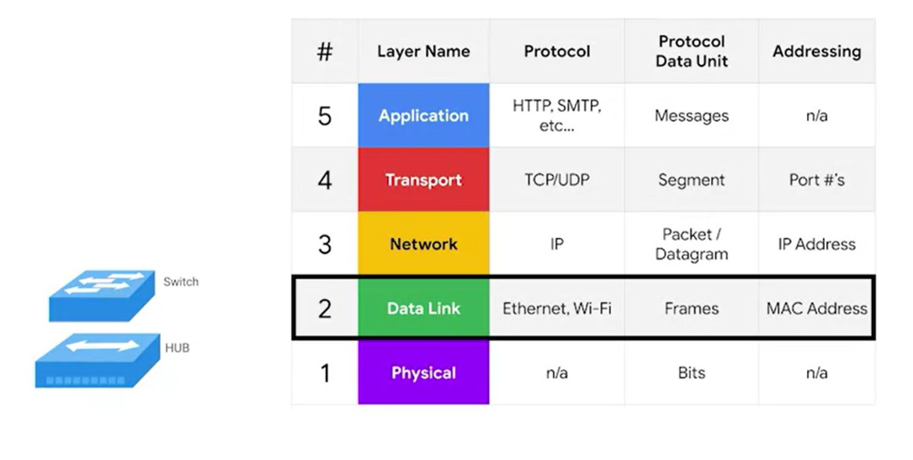

Slide 43
Hub and switches
The primary devices used to connect computers on a single network. Usually referred as a LAN, or local area network

Slide 44
recap

Slide 45
router
A device that knows how to forward data between independent networks

Slide 46
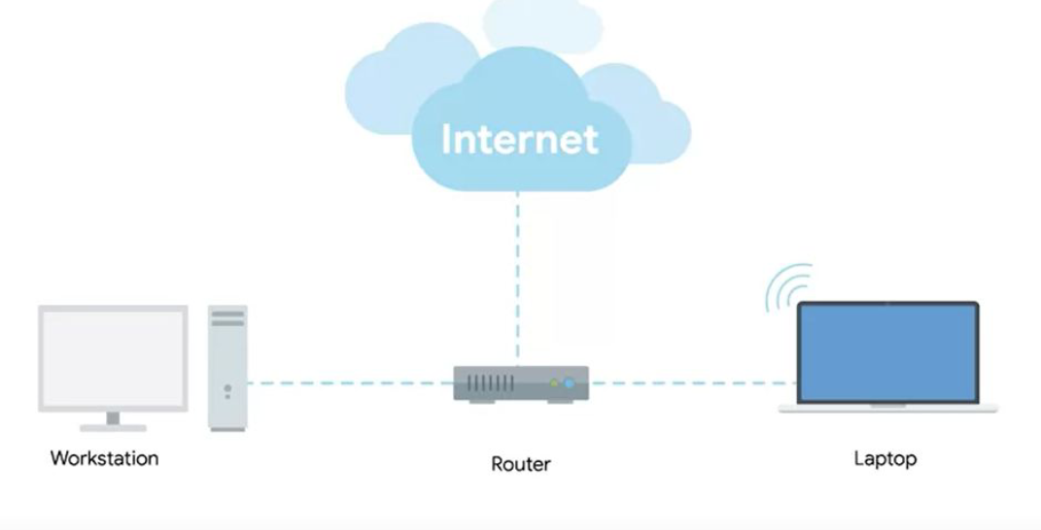

Slide 47
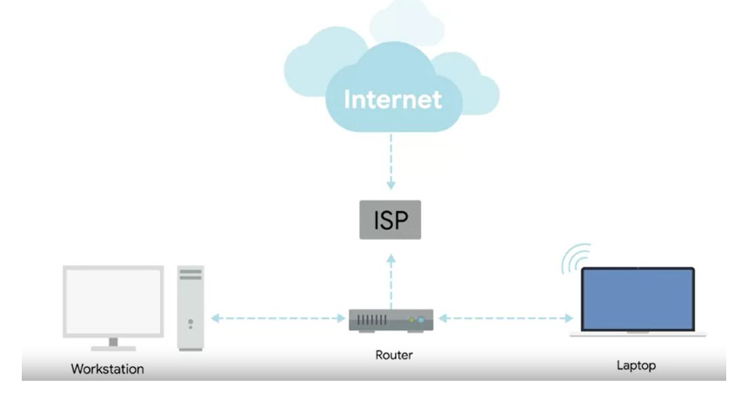
Internet service provider

Slide 49
Border gateway protocol (BGP)
Routers share data with each other via this protocol, which lets them learn about the most optimal paths to forward traffic.

Slide 50
NODE
A device connected to the network

Slide 51
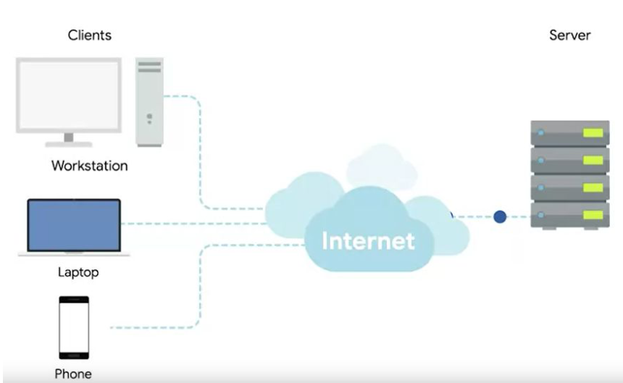

Slide 52
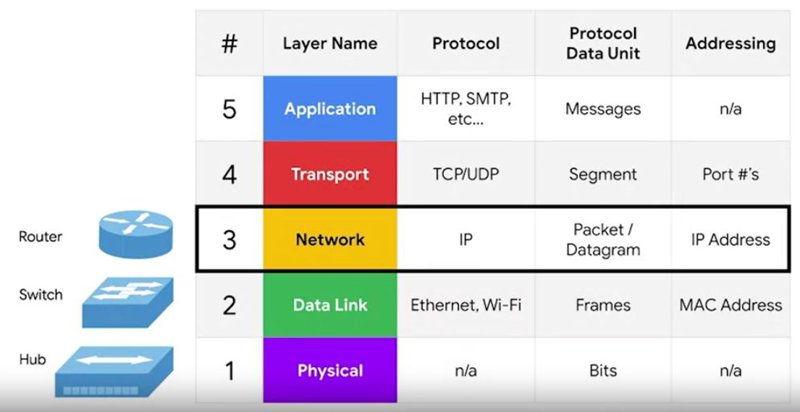

Slide 53
The physical layer
Layer 1

Slide 54
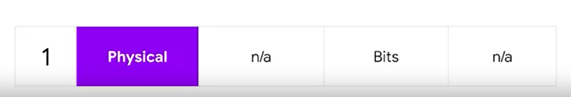

Slide 55
bit
In communication systems, a bit (binary digit) serves as the fundamental unit of data. It represents the smallest piece of information that can be transmitted or processed, which is either a 0 or a 1. These two values correspond to different states, such as on/off, true/false, or any other binary opposition, and are used in various encoding and modulation schemes to represent and convey information over communication channels.

Slide 56
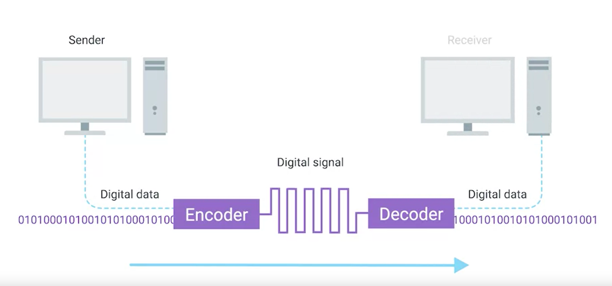
modulation
A way of varying the voltage of this charge moving across the cable

Slide 57
Twisted pair cable
The most common type of cabling used for connecting computing devices
It features pair of copper wires that are twisted together

Slide 58
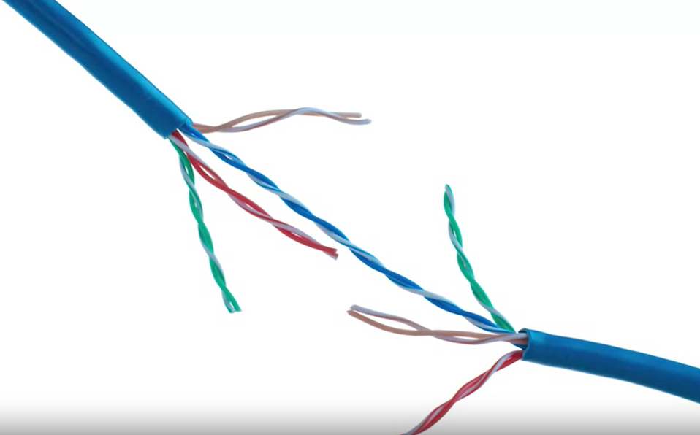

Slide 59
Duplex communication
The concept that information can flow in both directions across the cable

Slide 60
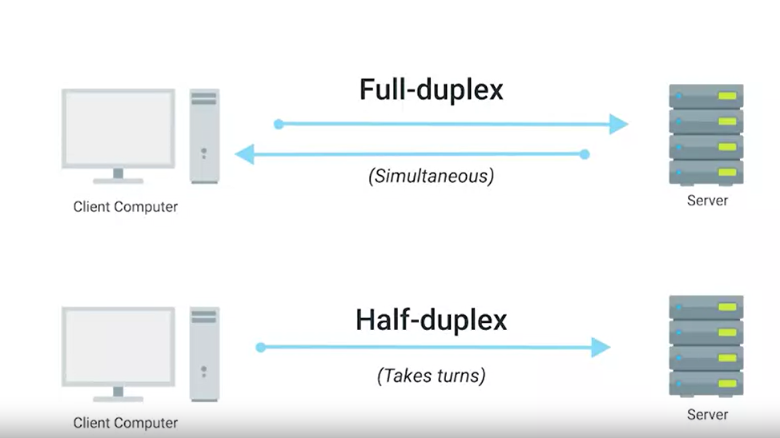

Slide 61
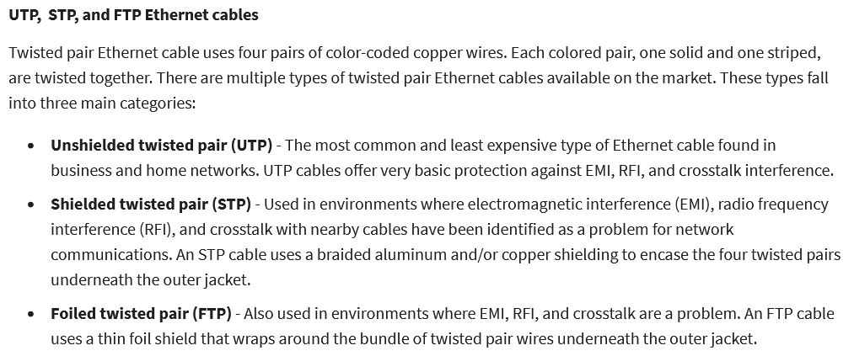

Slide 62
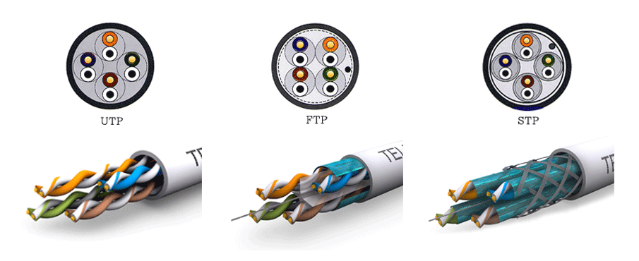

Slide 63
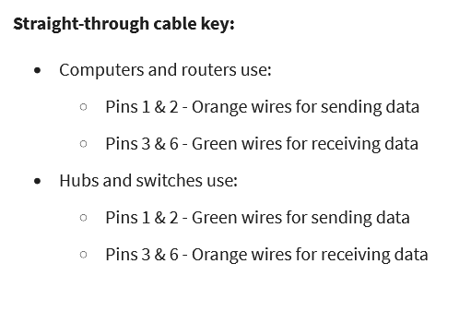

Slide 64
T568A/ T568B
T568A Configuration:
Green pair is placed at pins 1 and 2 (White/Green, Green)
Orange pair is placed at pins 3 and 6 (White/Orange, Orange)
T568B Configuration:
Orange pair is placed at pins 1 and 2 (White/Orange, Orange)
Green pair is placed at pins 3 and 6 (White/Green, Green)

Slide 65
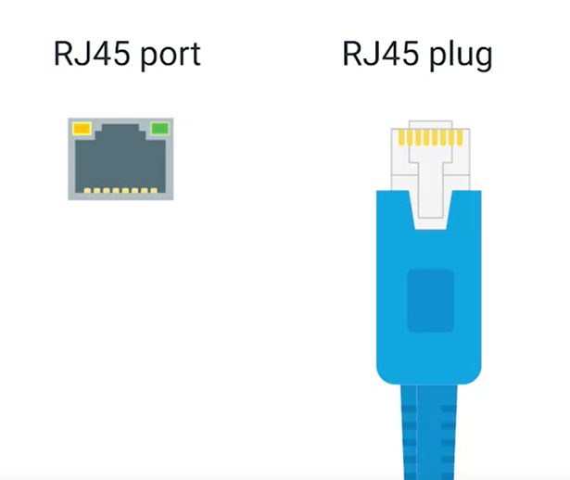
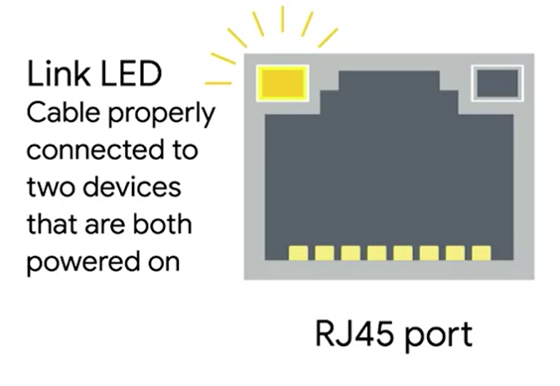
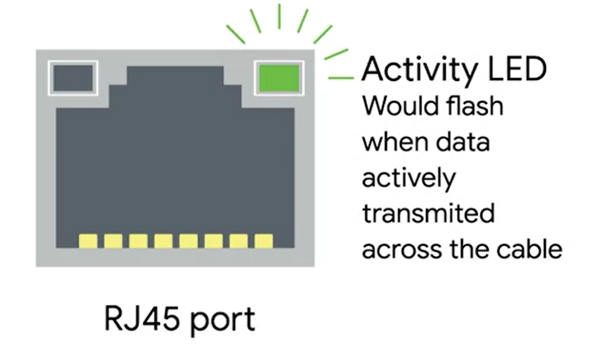
Network ports

Slide 66
DATA LINK layer
Layer 2

Slide 67

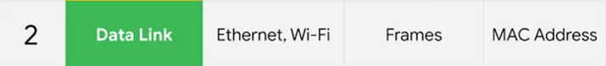

Slide 68
ETHERNET
Ethernet is widely used in various network setups, from simple home networks connecting a few devices to complex corporate data centers with thousands of connections. It provides a reliable and standardized way to network devices with different capabilities.

Slide 69
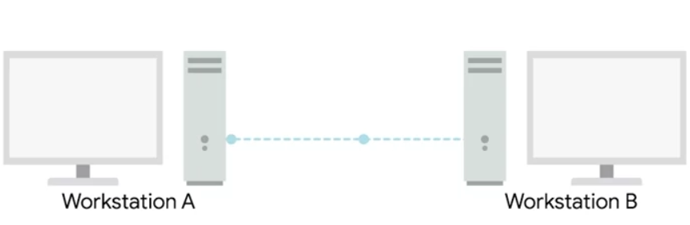
CSMA/CD
Carrier Sense Multiple Access with Collision Detection (CSMA/CD) is a network protocol for carrier transmission that is used in Ethernet networks to control access to the network medium. It's a fundamental part of the Ethernet standard for handling situations where two or more devices attempt to send data at the same time, leading to a collision.

Slide 70
NIC
A Network Interface Card (NIC), also known as a network card, network adapter, or LAN adapter, is a piece of computer hardware designed to allow computers to communicate over a computer network. It provides the physical interface between a computing device and the network cable, and it is a critical component for establishing a network connection.

Slide 71
MAC
A MAC address, short for Media Access Control address, is a unique identifier assigned to network interfaces for communications on the physical network segment. MAC addresses are used as a network address for most IEEE 802 network technologies, including Ethernet and WiFi. Essentially, it helps in ensuring that the physical devices in a network can be uniquely identified and communicated with.

Slide 72
FORMAT
A MAC address is typically a 48-bit (6-byte) or, in some cases, a 64-bit (8-byte) number. The 48-bit address is most commonly used and is represented in hexadecimal notation, divided into pairs (e.g., 00:1A:2B:3C:4D:5E).

Slide 73
Assignment
MAC addresses are usually assigned to the network interface card (NIC) by the manufacturer at the time of production, and thus they are also referred to as hardware addresses or physical addresses. The first half of the MAC address represents the manufacturer's unique identifier (also known as the Organizationally Unique Identifier - OUI), and the second half is the serial number assigned by the manufacturer.

Slide 74
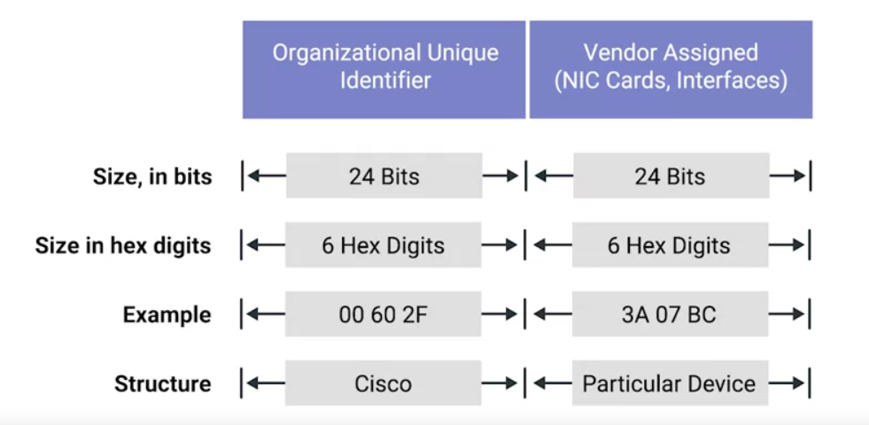

Slide 75
ETHERNET MAC
Ethernet uses MAC addresses to ensure that the data is sends has both and address for the machine that sent the transmission, as well as the one the transmission was intended for.

Slide 76
Unicast
Unicast is a one-to-one type of communication. In unicast, data packets are sent from a single source to a single destination with a unique address. It is the most common form of data transmission on the Internet.

Slide 77
Multicast
Multicast is a one-to-many type of communication. In multicast, data packets are addressed to a specific group of destination computers simultaneously. Only the devices that have joined a specific multicast group will receive the multicast packets.

Slide 78
Broadcast
Broadcast is a one-to-all communication method. In broadcast, data packets are sent from a single source to all possible destinations within the network segment or domain. Every device on the network receives the broadcast packets but only processes them if they are of interest; otherwise, they are discarded.

Slide 79
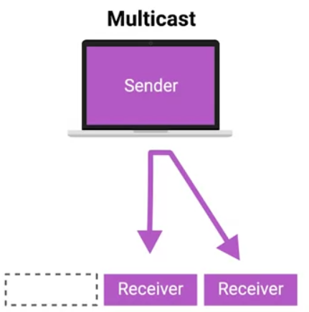
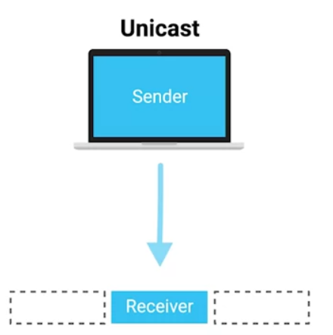
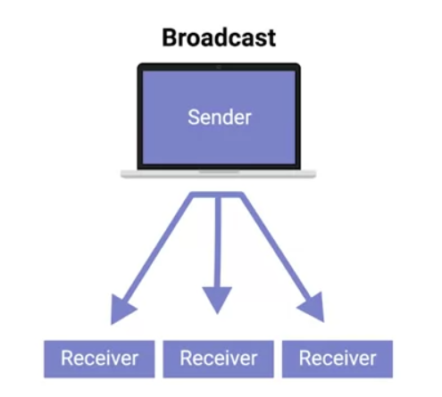

Slide 80
DATA PACKET
A data packet, often simply referred to as a "packet," is a formatted unit of data carried by a packet-switched network. In the context of computer networks, a packet is a small segment of a larger message or stream of data that’s transmitted over a network.

Slide 81
ETHERNET FRAME
An Ethernet frame is a specific structure used for framing data packets in Ethernet networks. It encapsulates the data packet for transmission over an Ethernet link. The frame structure is defined by various IEEE standards, with the most common being IEEE 802.3.

Slide 82
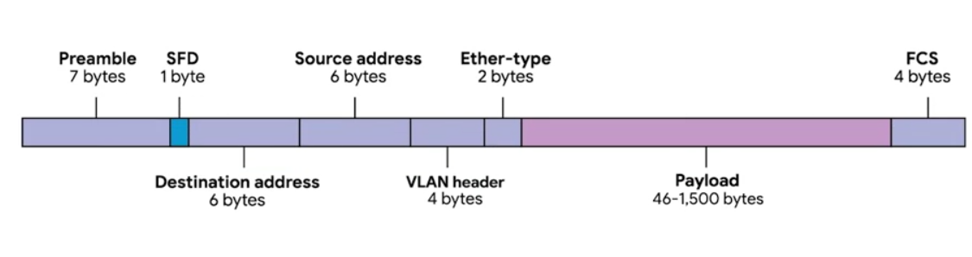

Slide 83
Preamble and Start Frame Delimiter (SFD)
Preamble (7 bytes): A sequence of alternating 1s and 0s that allows devices on the network to easily synchronize their receiver clocks, providing a buffer to establish bit-sync for the actual frame.
Start Frame Delimiter: Signals the beginning of the frame data with a specific byte pattern (10101011), marking the end of the preamble and the start of the Ethernet frame.

Slide 84
Destination MAC Address
The Media Access Control (MAC) address of the intended recipient of the frame. This could be a unicast (single device), multicast (group of devices), or broadcast (all devices) address.

Slide 85
Source MAC Address
The MAC address of the sender of the frame. This is used by the receiving device to know where the frame originated from.

Slide 86
EtherType/Length
EtherType: When used as EtherType, this field indicates the protocol of the encapsulated data packet, allowing the receiving device to properly interpret the payload.
Length: Alternatively, it can signify the length of the payload in bytes.

Slide 87
Payload
The actual data being transported. This includes any headers for other protocols carried within the Ethernet frame, such as an IP packet.

Slide 88
Frame Check Sequence
A cyclic redundancy check (CRC) used for error checking. The FCS allows the receiver to detect some types of errors in the transmission. If the FCS does not match the calculated value, the frame is discarded.

Slide 89
NETWORK layer
Layer 3

Slide 90
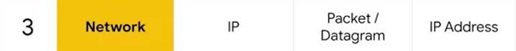

Slide 91
IP
The Internet Protocol (IP) is a set of rules governing the format of data sent over the Internet or other networks. IP is a fundamental protocol within the Internet protocol suite, which is a collection of networking protocols that includes TCP, UDP, and many others.

Slide 92
IP
Dynamic
Static

Slide 93
Static IP Addresses
A static IP address is a fixed address that is manually assigned to a device and does not change over time. Once a device is assigned a static IP address, that address remains the same until it is manually changed, or the device is removed from the network.

Slide 94
Usage
Static IP addresses are typically used for devices that need to maintain the same IP address for an extended period, such as servers, network printers, or other devices that need to be reliably accessed by the same IP address. They are also used for DNS servers, VPN gateways, and devices that require remote access.

Slide 95
Dynamic IP Addresses
A dynamic IP address is assigned to a device for a limited period or until the device disconnects from the network, using a DHCP server. When the lease for an IP address expires, the device may be assigned a new IP address.

Slide 96
Usage
Dynamic IP addresses are commonly used for consumer devices, such as personal computers, smartphones, and tablets connected to a residential internet connection, or devices in corporate environments that do not require permanent IP addresses.

Slide 97
IPV4
IPv4, or Internet Protocol version 4, is the fourth revision of the Internet Protocol (IP) and a widely used protocol in data communication over different kinds of networks. IPv4 is the first version of the protocol to be widely deployed, and it forms the basis for most of the Internet's current architecture.

Slide 98
32-bit Addressing
IPv4 addresses are 32 bits long, which allows for a theoretical maximum of about 4.3 billion unique addresses (2^32). However, large blocks of addresses are reserved for special uses and cannot be allocated for public internet routing, reducing the number of addresses available for general use.

Slide 99
Address Notation
IPv4 addresses are typically expressed in dotted-decimal format, which divides the 32-bit address into four 8-bit fields. Each field is then represented as a decimal number (ranging from 0 to 255) and separated by periods. For example, 192.168.1.1 is a standard representation of an IPv4 address.

Slide 100
